Slide 1
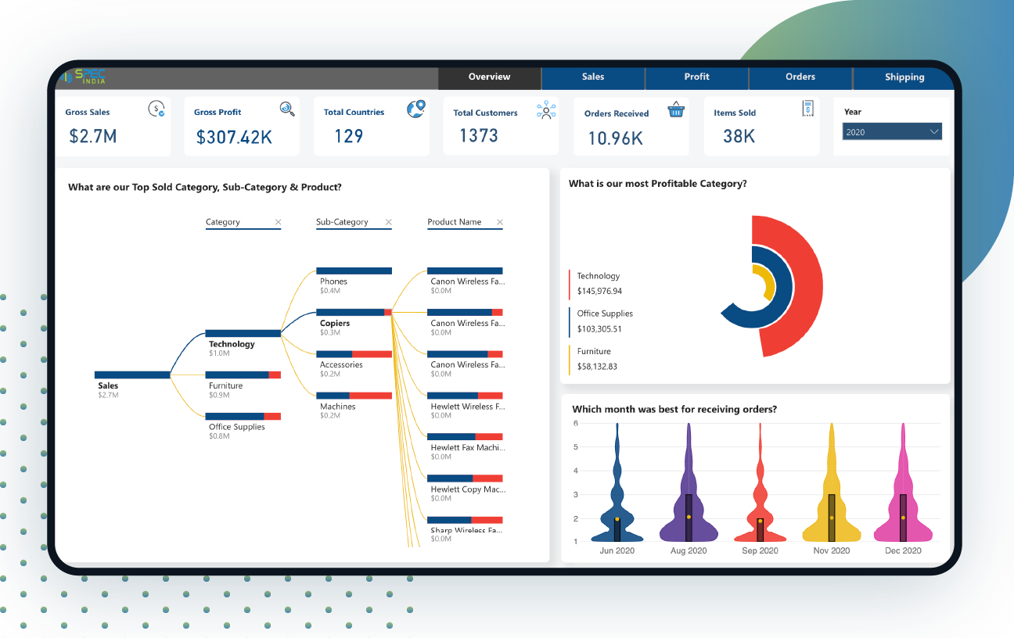
Customer Shopping Behavior Analysis
Leveraging Consumer Data for Business Growth
TARUN KARI
A report by

Slide 2

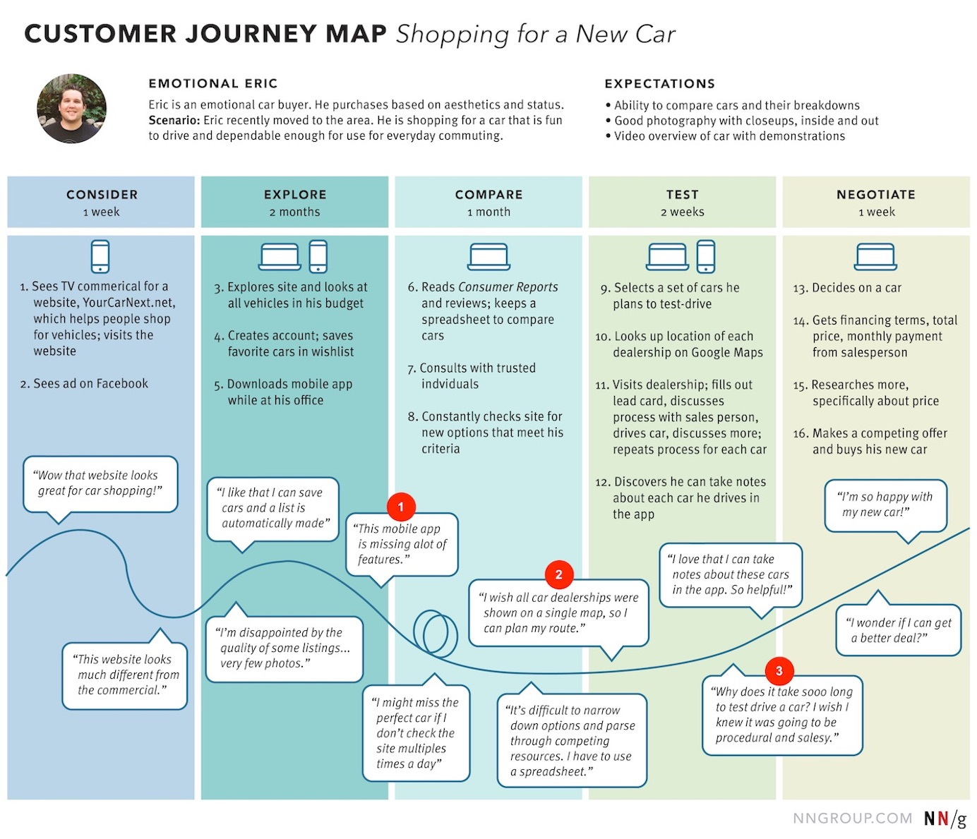


Project Overview & Business Problem
Business Challenge
Leading retail company seeking to understand customer behavior
Noticed changes in purchasing patterns across demographics
Need to identify factors driving consumer decisions
Key Objectives
Improve sales performance
Enhance customer satisfaction
Build long-term customer loyalty
Business Question
How can the company leverage consumer shopping data to identify trends, improve customer engagement, and optimize marketing and product strategies?

Slide 3






Dataset Summary & Key Features
3,900
18
Rows (Purchases)
Columns (Features)
Customer Demographics
Purchase Details
Shopping Behavior
Age
Item Purchased
Discount Applied
Gender
Category
Previous Purchases
Location
Purchase Amount
Frequency of Purchases
Subscription Status
Season
Review Rating
Size
Shipping Type
Color
Missing Data: 37 values in Review Rating column

Slide 4





Data Preparation & Cleaning Process
Data Loading
Exploration
Cleaning
Engineering
Integration
Import dataset using pandas
Initial analysis with df.info() and .describe()
Handle missing values & standardize columns
Create new features for analysis
Load to PostgreSQL database
Data Cleaning
Feature Engineering
Imputed missing values in Review Rating using median of each product category
Created age_group column by binning customer ages
Generated purchase_frequency_days from purchase data
Renamed columns to snake case for consistency
Performed data consistency checks across columns
Verified and removed redundant promo_code_used column
df['age_group'] = pd.cut(df['age'], bins=[0, 25, 40, 60, 100], labels=['Young', 'Adult', 'Middle', 'Senior'])
df['review_rating'] = df.groupby('category')['review_rating'].transform(lambda x: x.fillna(x.median()))

Slide 5


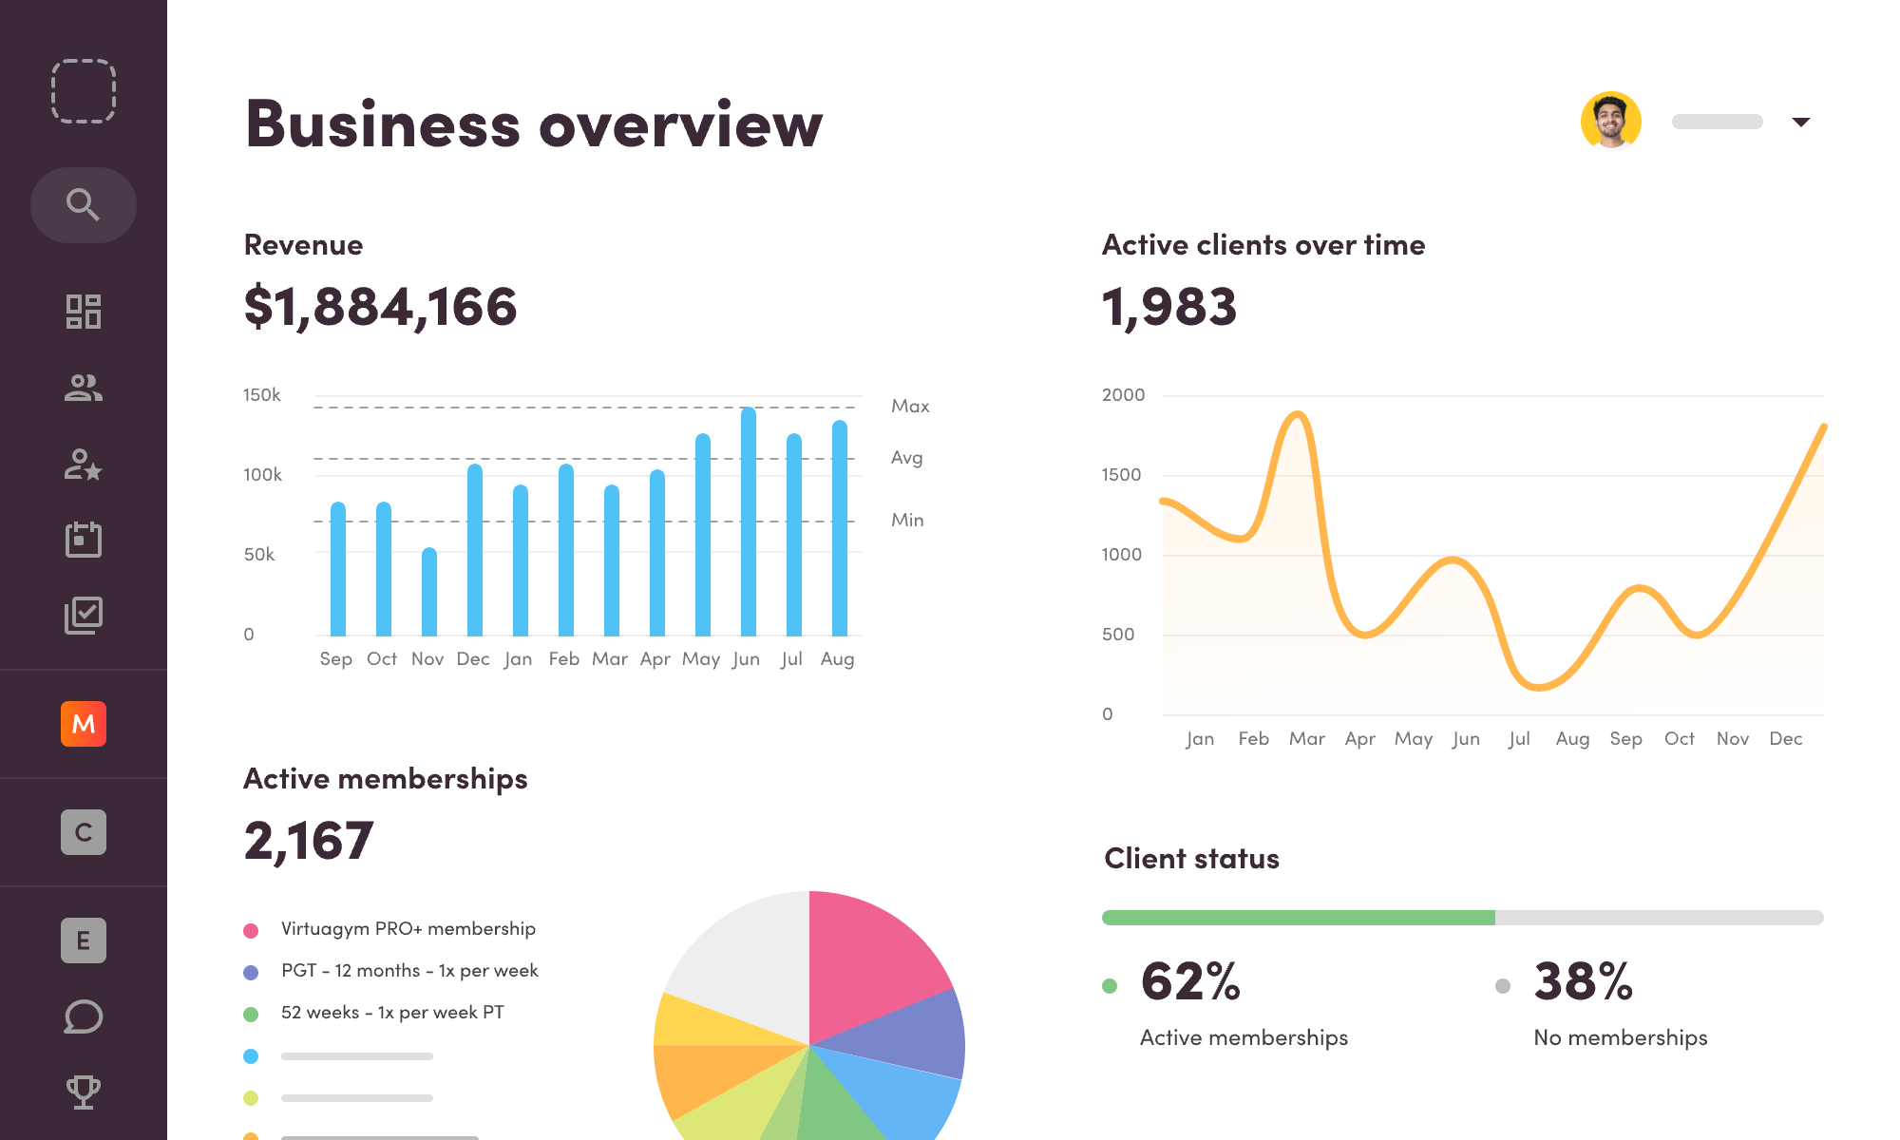






Exploratory Data Analysis (Python)
Analysis Techniques
Purchase Distribution by Category
Summary Statistics
Data Visualization
Descriptive statistics for numerical and categorical variables
Distribution plots, histograms, and count plots
df.describe().T
sns.countplot(x='category', data=df)
Correlation Analysis
Customer Segmentation
Heatmap to identify relationships between variables
Grouping by demographics and purchase behavior
Category analysis reveals clothing and accessories as top performers
sns.heatmap(df.corr(), annot=True)
df.groupby('gender')['purchase_amount'].mean()
Behavioral Insights
Age distribution shows highest concentration in 25-45 age group
Customers with subscriptions show 25% higher loyalty
Purchase amount varies significantly across product categories
Discount usage correlates with higher purchase frequency
Express shipping users spend 15% more per transaction
Review ratings show minimal variation across seasons
Subscription status impacts average purchase amount by 18%
Discount sensitivity varies by age group and gender

Slide 6









SQL Analysis & Key Business Questions
We performed structured analysis in PostgreSQL to answer 10 key business questions about customer behavior and purchasing patterns.
1
Revenue by Gender
2
High-Spending Discount Users
Compared total revenue generated by male vs. female customers
Identified customers who used discounts but spent above average
3
Top 5 Products by Rating
4
Shipping Type Comparison
Found products with the highest average review ratings
Compared average purchase amounts between Standard and Express
5
Subscribers vs. Non-Subscribers
Compared average spend and revenue across subscription status
6
Discount-Dependent Products
Identified 5 products with highest percentage of discounted purchases
7
Customer Segmentation
8
Top 3 Products per Category
9
Repeat Buyers & Subscriptions
10
Revenue by Age Group

Slide 7




Key Insights from Analysis
Customer Segmentation
Purchase Behavior Trends
32%
of customers classified as Loyal segment
42%
of revenue from repeat customers
Loyal customers spend 45% more per transaction
Winter season shows highest average purchase value
New customers have highest discount usage (68%)
Apparel category drives most frequent purchases
Returning customers show strongest seasonality
Subscription status strongly correlates with loyalty
Discount Effectiveness

Slide 8
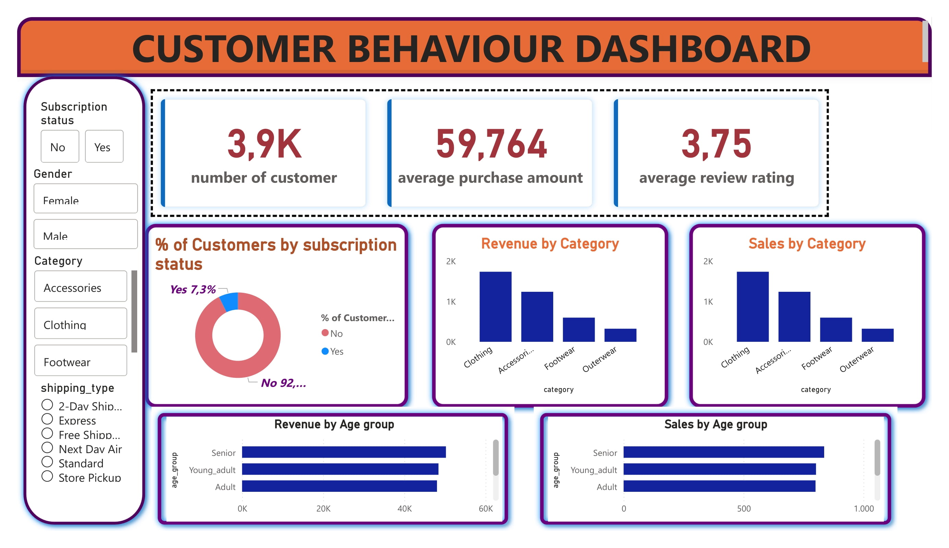


Power BI Dashboard Highlights
Key Visualizations
Revenue heat map by category and season
Customer journey funnel with conversion rates
Product performance matrix with ratings
Demographic breakdown of purchase behavior
Interactive Filters
Date range selector for temporal analysis
Customer segment toggles for targeted views
Interactive Retail Analytics Dashboard
Product category multi-select filters
Real-time visualization of customer behavior patterns, purchase trends, and product performance metrics
12
8
Filter Options
Visual Elements

Slide 9





Business Recommendations
Based on our analysis, here are the 5 key recommendations to optimize business performance
Boost Subscriptions
Customer Loyalty Programs
Review Discount Policy
Promote exclusive benefits
Reward repeat buyers
Balance sales with margins
Early access to new products
Tier-based benefits
Targeted discount strategies
Members-only discounts
Points accumulation system
Seasonal promotion calendar
Impact:
Impact:
Impact:
Highlight top-rated products
Focus on high-revenue age groups
Strategic product placement
Personalized campaigns
Cross-selling opportunities
Express-shipping user targeting

Slide 10





Conclusion & Next Steps
Next Steps
Key Takeaways
01
02
Implement customer loyalty program with tier-based rewards
Develop targeted marketing campaigns for high-value segments
3,900
Transactions analyzed for comprehensive insights
Customer segmentation reveals distinct purchasing patterns
03
04
Discount effectiveness varies by category and demographics
Refine discount strategy based on category sensitivity
Expand subscription benefits to drive enrollment
Subscription status strongly correlates with loyalty and spending
05
06
Seasonal trends impact product preferences and purchase amounts
Implement continuous monitoring of customer behavior
Schedule quarterly reviews of KPIs and strategies
Thank You For Your Attention!
tarunkari0411@gmail.com
+49 15560711688
Berlin, Germany

